Slide 1
MESSAGE SEND TIME OPTIMIZATION
Ildi Czeller
Data Scientist @Emarsys
@czeildi on twitter, github
Notes:
I will tell the story of how we optimized the sending times of hundred millions of messages so far with the help of R. I will tell you about both the technical and business side of this 2 year long project. This project is a work of the data team at Emarsys where I am a data scientist for more than 2 years now.

Slide 2
1. Motivation 2. initial solution
3. Adjustments & results
Notes:
The story has three main parts, motivation and background; then our initial solution and finally adjustments and results. You will see that these are intertwined: examining the existing results motivated adjustments which then brought about different changes. The whole journey so far was a very exciting learning curve for us as both the team was new and this was the product where machine learning is essential but not naturally expected like with recommender systems.

Slide 3
1500+ CLIENTS
2.5B CONTACTS
personal marketing communication at scale
Notes:
To understand the business problem, I will tell you a little bit about Emarsys. We are a software technology company building a platform for marketers. We have more than fifteen hundred clients who are businesses and they together have 2 and half a billion end users. Our goal is to do personal marketing communication at this scale which means we need automated solutions for personal communication.

Slide 4
Content timing channel
Notes:
Personalization has three main components: content, timing and channel.By channel I mean whether to send email campaigns, sms or mobile push notifications. In the following we will look at how to tackle the challenge of personal timing.

Slide 5


TIMING WITHIN DAY
Notes:
More specifically we tackle the challenge of optimizing within a day. It seems intuitive that there are people with different kind of habits, some prefer to work through their emails every morning, others only look at emails during work hours.

Slide 6
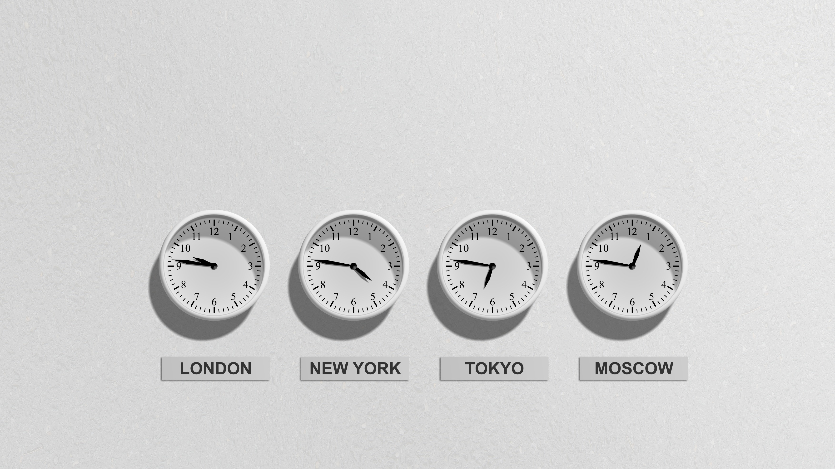
NO CONSISTENcy
Notes:
At first we looked for an easy solution: we examined when customers open their emails or how soon they open them after they receive a message. We found no clear pattern in neither of them so we decided to took a step back which turned out to be very fruitful. (remark: hangsúlyozni hogy nem időzóna problémáról van szó)

Slide 7

WHAT CAN WE WIN?
_
?
Notes:
So we asked ourselves: What can we win by optimizing sending times? What can we expect from the best possible algorithm? Can we expect significantly better engagement? Would our clients use such a solution? These are essential to answer before we invest years in research and development.

Slide 8
OBSERVED ENGAGEMENT
 | 06:00 open rate | 16:00 open rate
Claire | 2 open /4 send = 50% | 3 open /10 send = 30%
Notes:
First we focused on open events, more specifically open rate which is the ratio of the number of opened messages to the number of sent messages. Here you can see the observed engagement to one particular contact. We observe different reactions to emails sent at different times. What do you think, when should we send to Claire? To estimate a rate 4 send is very few. Is this pattern of underlying preferences or just the artifact of observing a realization?

Slide 9
Pattern or chance?
Notes:
We want to answer whether difference between hours is a pattern we could benefit from or chance. To model opens we assume that contacts have a long term open probability which can only change slowly and they open every one of their emails with this probability.

Slide 10
Possible causes
Few observations
Actual preferences
Notes:
What scenarios can result in the specific observations we saw earlier? Few observations are a reason for sure but does that explain all the pattern?

Slide 11
Simulate
KEEP Few observations
ASSUME NO Actual preferences
Notes:
We used simulation to assess the typical amount of variance. In order to identify the added effect of contacts’ preferences it was crucial to keep few observations on contact level. In the simulation we could assume no actual preferences, in other words we simulated with the same probability at all sending hours.

Slide 12
Claire’s observed engagement:
 | 06:00 open rate | 16:00 open rate | 20:00 open rate | average open rate | standard deviation
Claire | 3/4 =75% | 2/10=20% | 12/30 =40% | 17/44 =39% | 0.28
Claire’s simulated engagement:
 | 06:00 open rate | 16:00 open rate | 20:00 open rate | average open rate | standard deviation
Claire | 1/4 =25% | 6/10=60% | 14/30 =47% | 21/44 =48% | 0.17
Notes:
We used the empirical open rate of the contact regardless of sending hour as the baseline for simulation. We measured variance with standard deviation. If observed standard deviation is higher then we lean towards actual pattern. Of course from one contact we still cannot learn valuable insights.

Slide 13
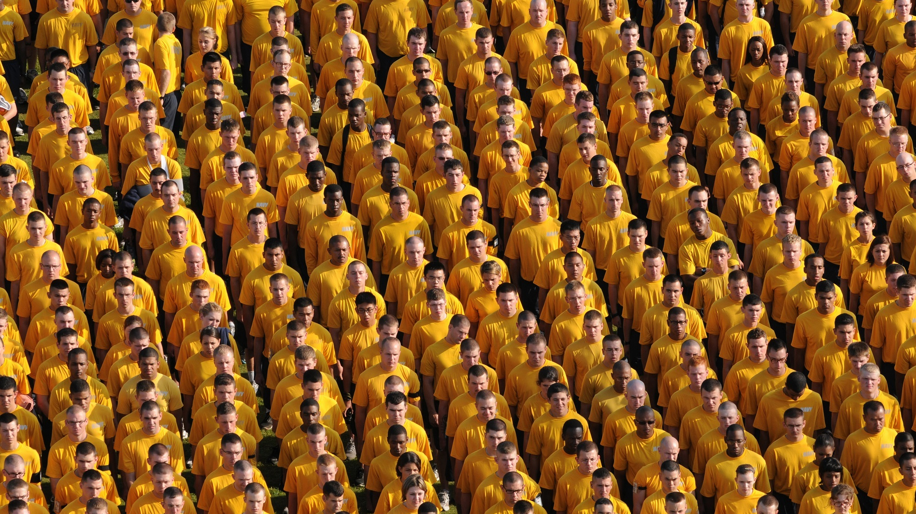
Notes:
Luckily we can exploit the fact that although we have few observations on the contact level we have at least a hundred thousand contact of each of our clients. So we turned to the wisdom of the crowd.

Slide 14
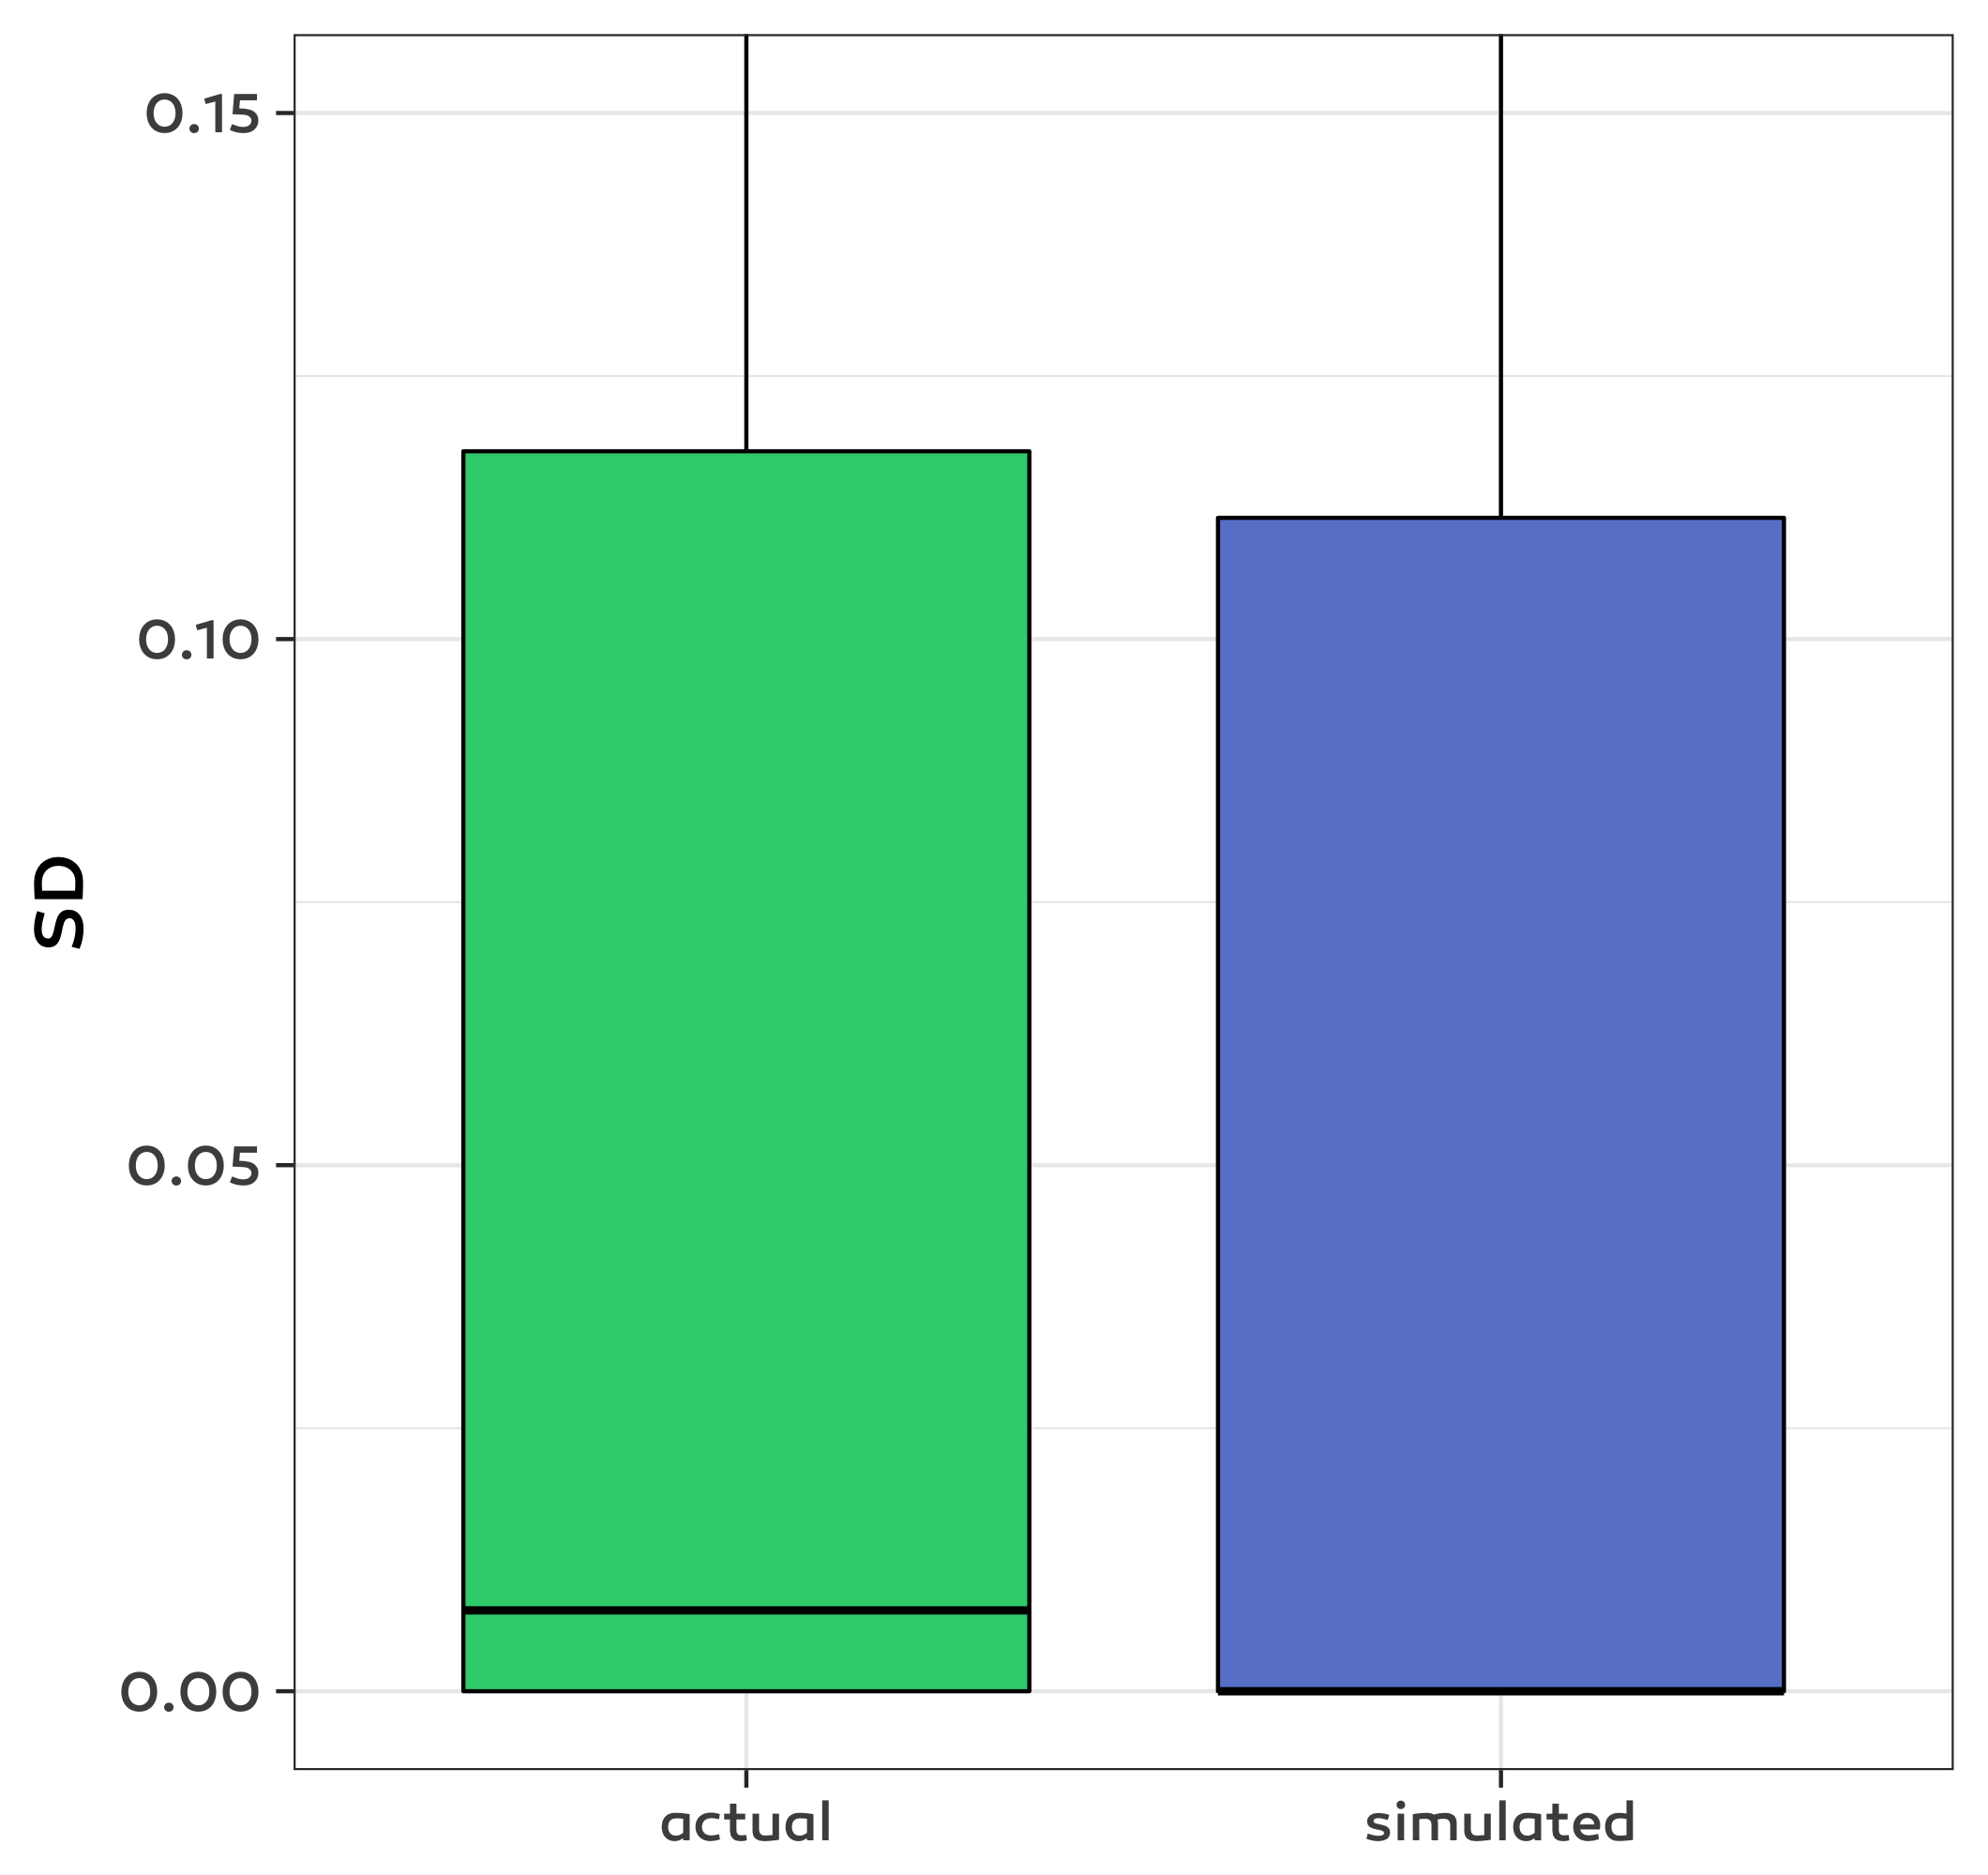
PATTERN, NOT CHANCE
Notes:
More precisely we see that in reality there are consistently bigger variances between different sending times so we can conclude that timing matters. Around this simulation we built a shiny app which made it convenient to explore different clients, distribution, effect of different filterings etc.

Slide 15
1. Motivation 2. initial solution
3. Adjustments & results
Notes:
Now we know that we want to optimize sending times, the next question is how to optimize them.

Slide 16
Key challenges
High uncertainty
Results expected from day 1
Notes:
Key challenges include email numbers per contact ranging from 0 to 200 to management expectations from day 1 as this was not another machine learning solution but a flagship product of truly personal marketing.

Slide 17

Bayesian bandit algorithm
Notes:
After considering some alternatives we settled with the so called bayesian bandit algorithm. This is a widely used algo, part of a more general framework and under active research. The core idea comes from slot machines: they pay with different expected value but you do not know the details. How to play on these slot machines to maximize your wealth on the long run? To translate to our use case we do not know the long term open probabilities of the contacts at each possible sending hour. We want to maximize open rates on the long run. We have a new piece of information with every sent message based on whether the contact opened it or not. I can advice Chris Stucchio’s posts to learn about business use cases of bandit algorithms. I will give you references in the end.

Slide 18
exploration & exploitation
Notes:
the core idea is keeping a continuous balance between exploration and exploitation. We target better slots more but always keep exploring to allow for the possibility that we we perceive as best is not the best on the long run.

Slide 19
Convince pilots to try
NEXT challenge
Notes:
Now that we have the details of a machine learning solution in which we firmly believe the next challenge is to convince some of our clients to try it. (With every significant product it is crucial to first try with a few of our clients. Experience from this testing period often greatly shape the product until global release.) Why they need convincing? For many, this is the first time they use a machine learning solution in a marketing setup. In order to trust our solution they want to understand the algorithm on a high level, understand worst and best case scenarios. In other words they wanted an intuition about the algorithm both on contact level and globally. This part is crucial in building trust for further machine learning products as well.

Slide 20
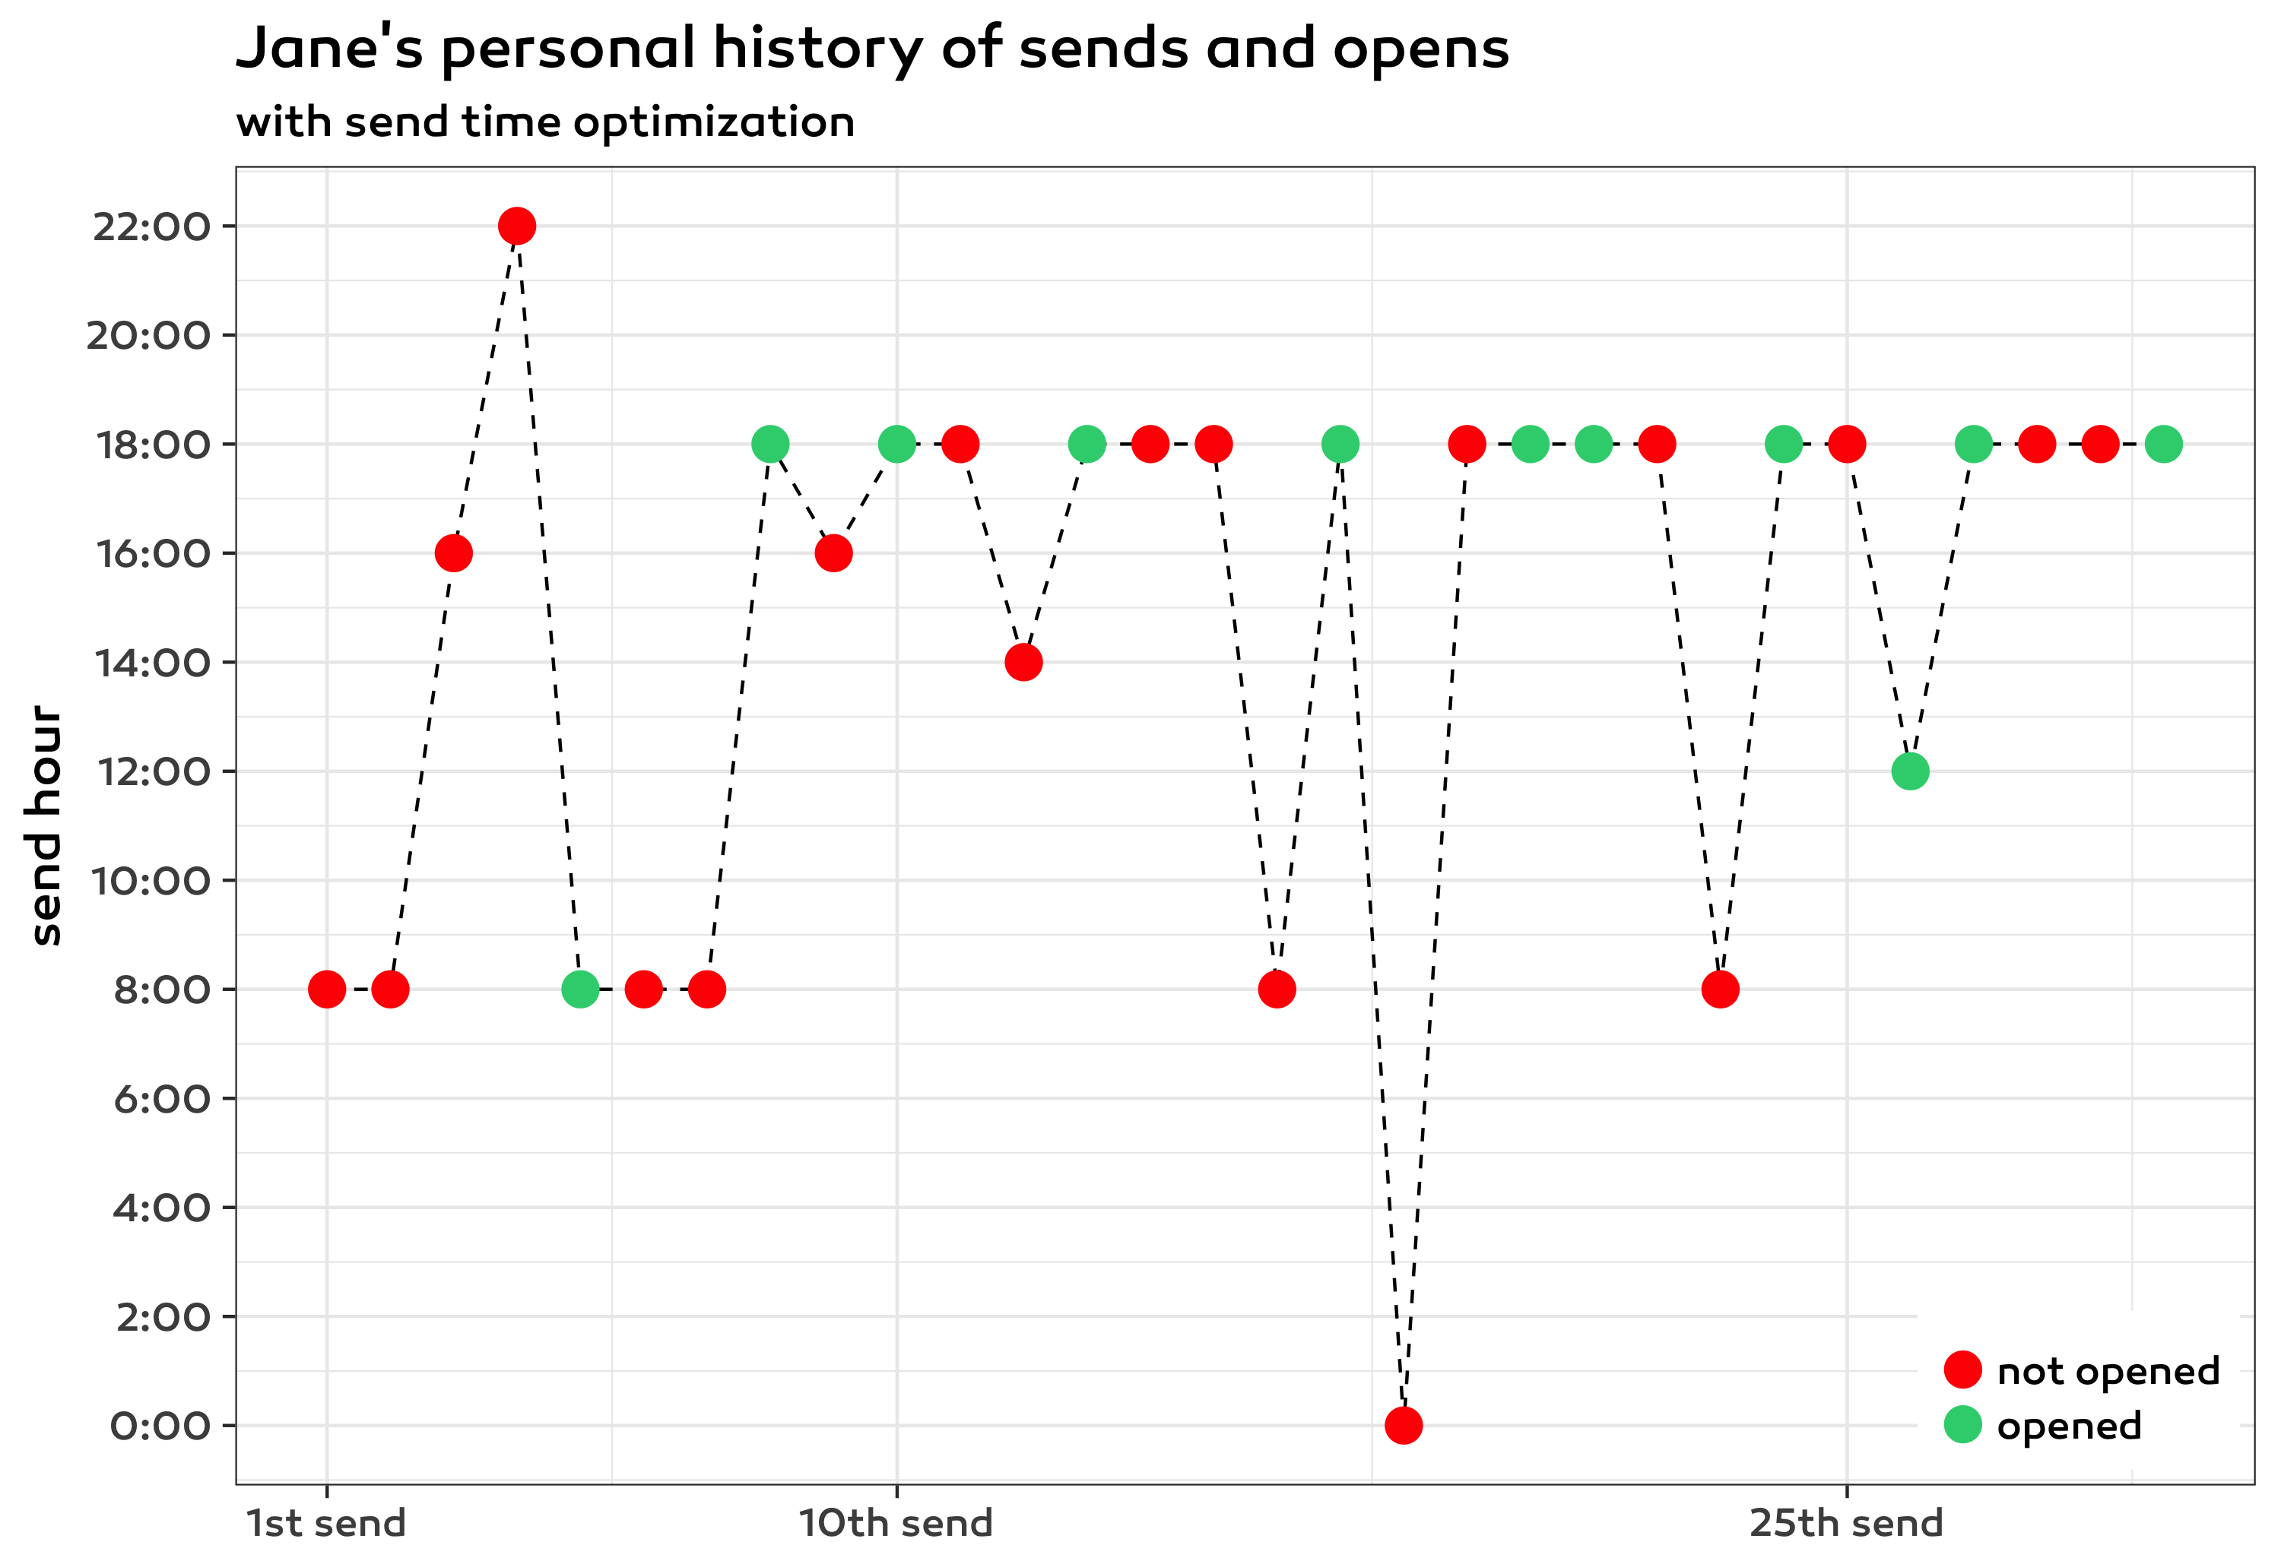
Notes:
This graph shows a possible history for one particular contact, Jane. From left to right we can see her consecutive email campaigns and at which time we sent them to her. Red means no open, green means open. This chart depicts exploration but also that mostly we send at the most successful time.

Slide 21
Theory: asymptotic results results NEEDED in short term
Notes:
To understand the global aspects it is good to state that most scientific articles are about asymptotic results and have many assumptions such as independence while we need results in the short term and do not have strong independence besides others.

Slide 22
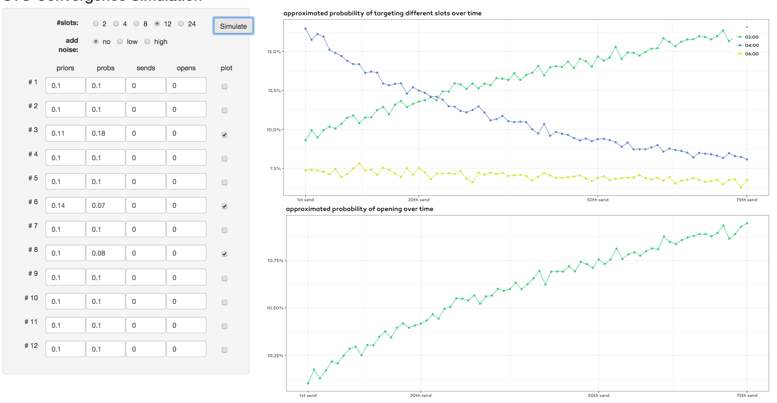
ADAPTED THEORY
Notes:
Here you can see a simulation that with a specific setup about available past information and real long term open probabilities how the probability of targeting the best slot and open rate would increase by applying the Bayesian bandit algorithm. This is an app built with shiny which allowed us to tailor the parameters to specific clients and answer their questions on the spot. This simulation helped the clients to understand both that the optimization needs several campaigns to realize its full potential and the magnitude in which they can expect uplift.

Slide 23
data & management & clients on board
bayesian bandit ALGO + EXPLANATIONS
Notes:
Now we had both data, management and the clients on board. So usage in production starts!

Slide 24
1. Motivation 2. initial solution
3. Adjustments & results
Notes:
Let’s see what we learned from this piloting phase.

Slide 25
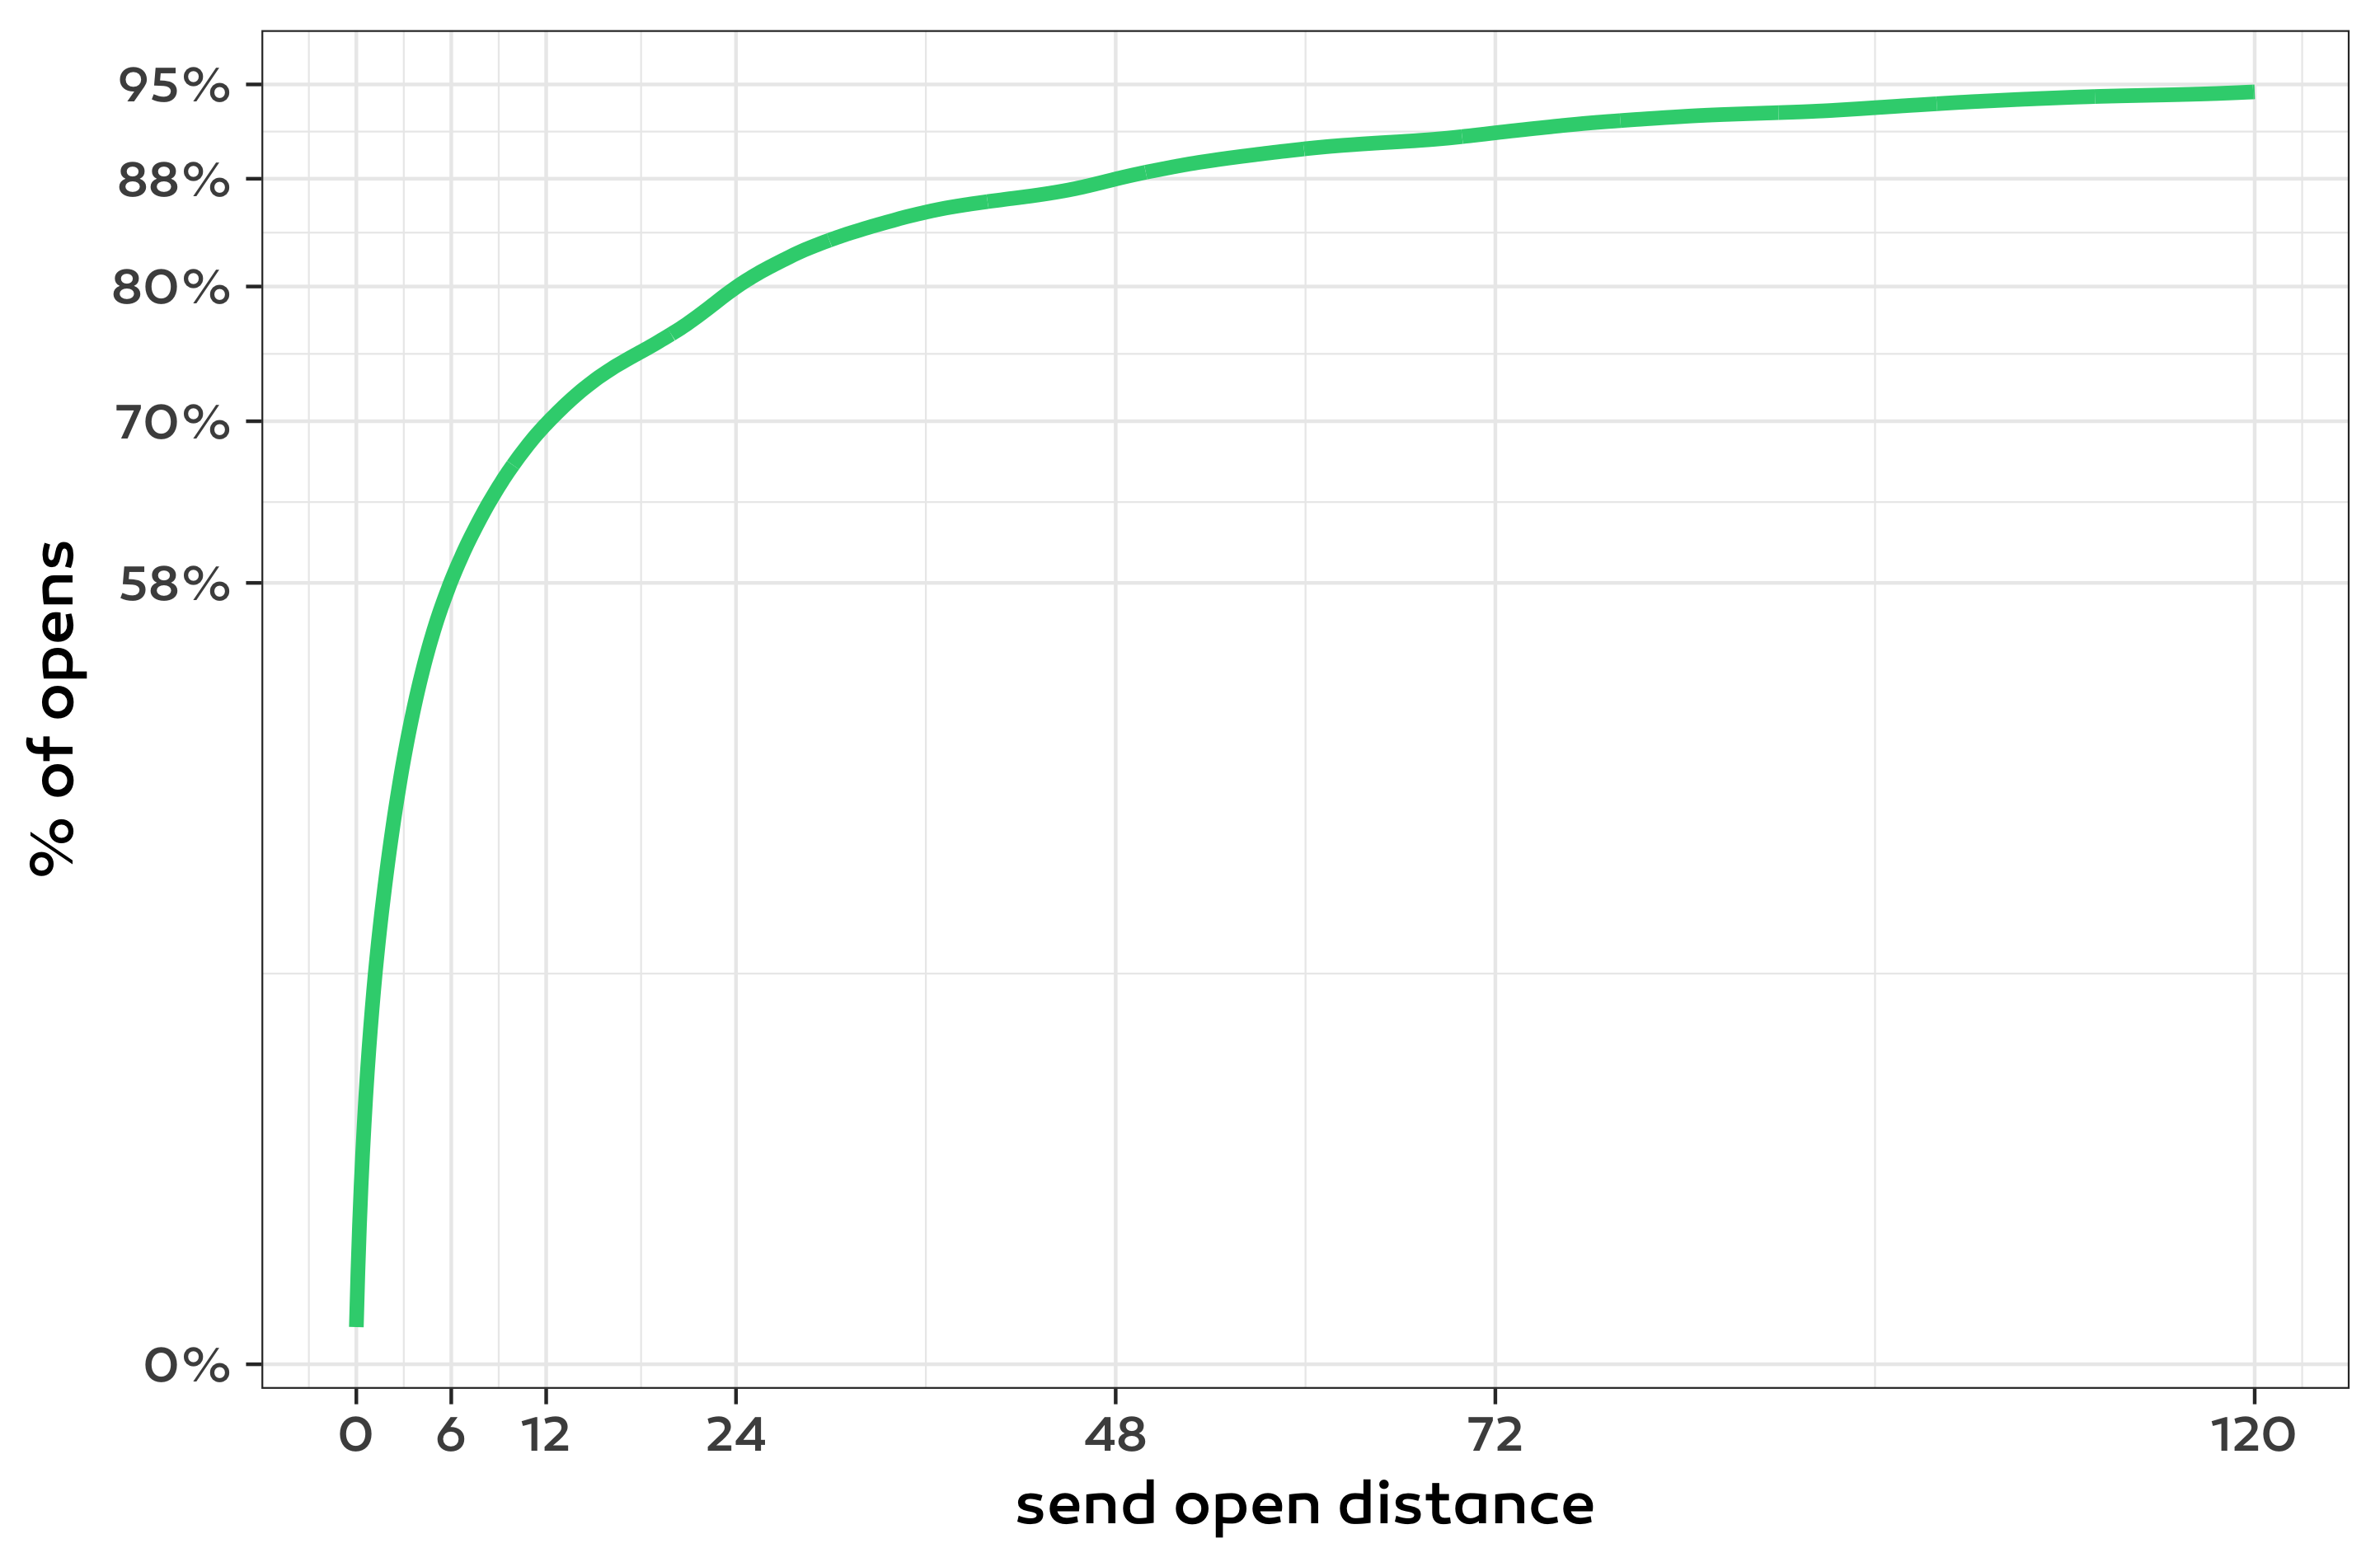
WAIT FOR OPENS
Notes:
In this chart you can see that what % of opens happens after 6, 12 24 etc hours. 6 hours after sending around 60% of the opens happen, and after 2 days still less than 90%. This means that we have to wait until we can incorporate information about the newest sends. If you use fresh data immediately, it will be biased: with a recent send no open might not happened yet so you don’t want to count as non open. After exploring this chart for many clients and campaigns we settled with using a 2 day window.

Slide 26
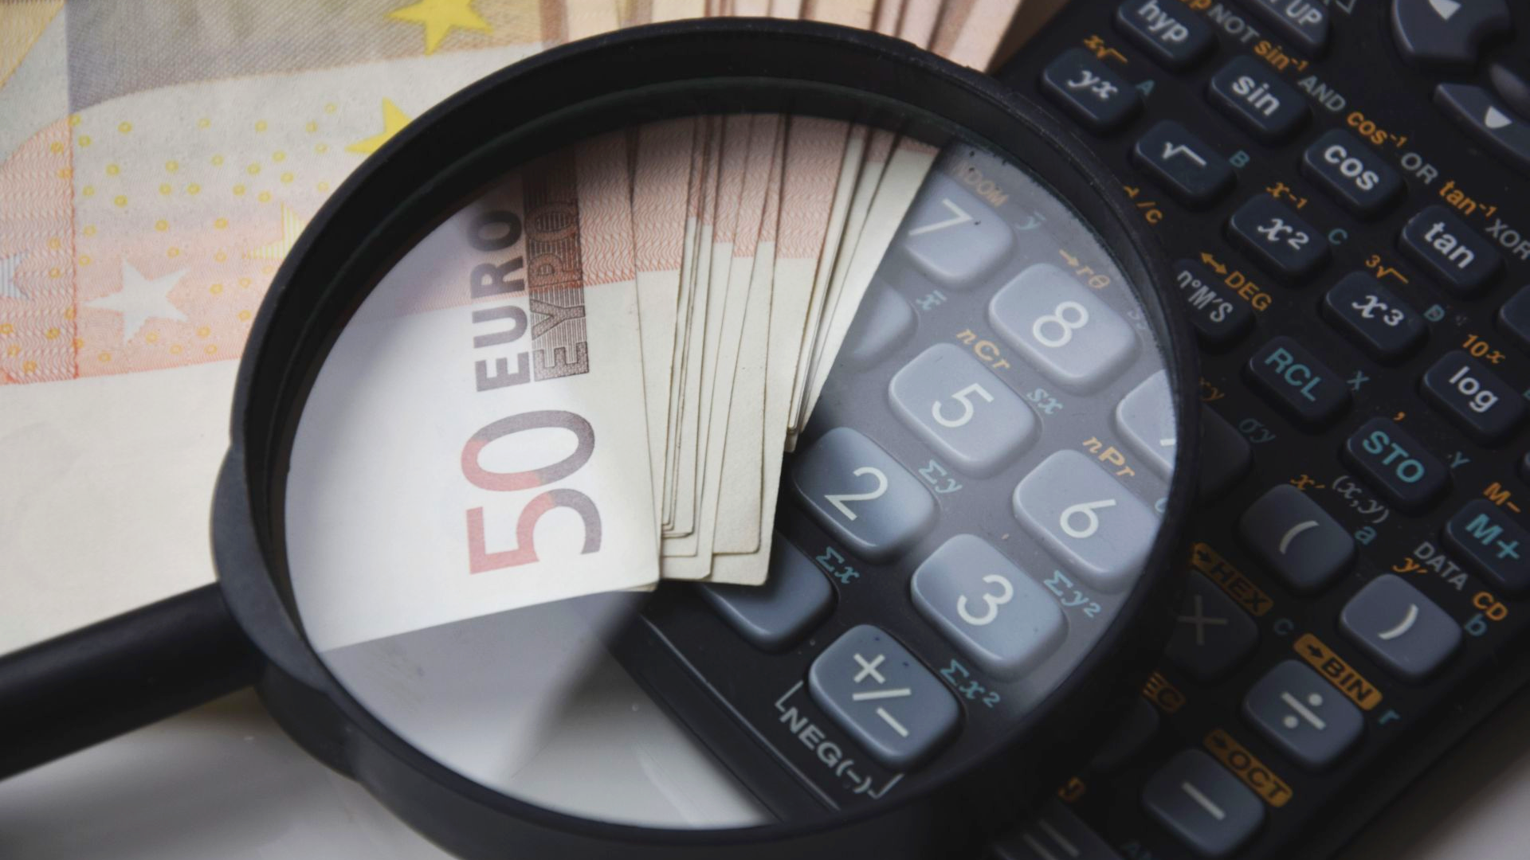
A/B test
Notes:
The optimization is a bandit type algo we still need a way to measure its success: we used A/B testing for it: the control group receives exactly the same message at a fixed time, usually the time the marketer would set.

Slide 27
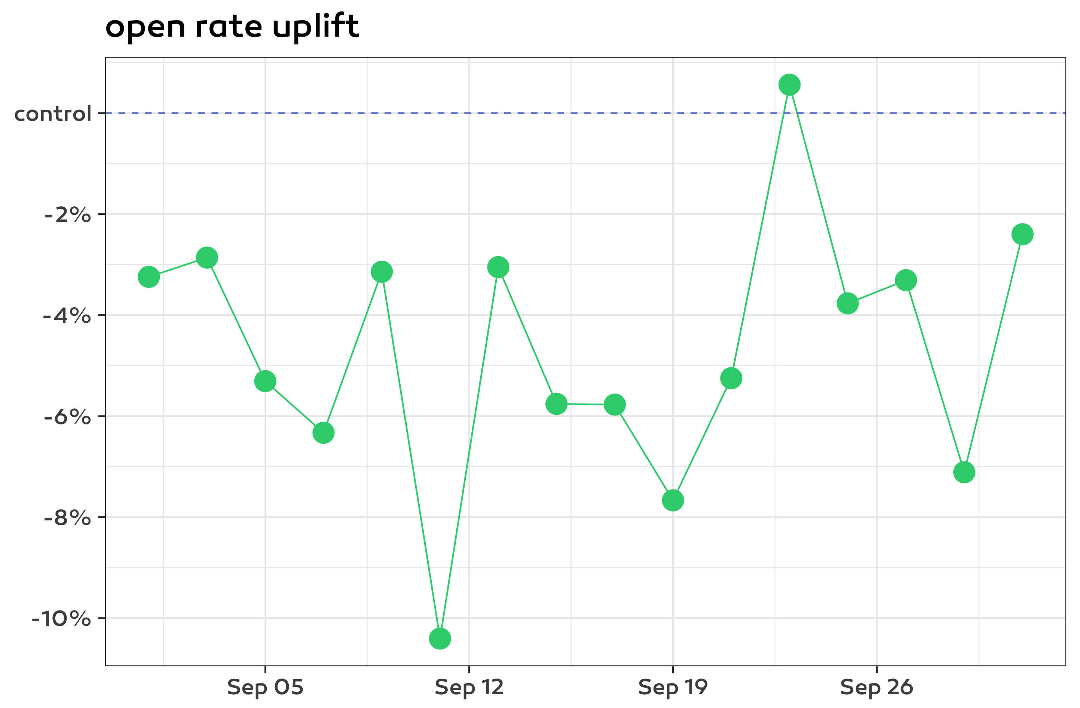
Notes:
Each point corresponds to a campaign sent with send time optimization on a given day. We calculated open rate in both the control and in the send time optimized group and then here you can see the uplift: how much is the send time optimized open rate higher. With our first pilot we were naturally very excited about the results but were anxious seeing this chart first.

Slide 28
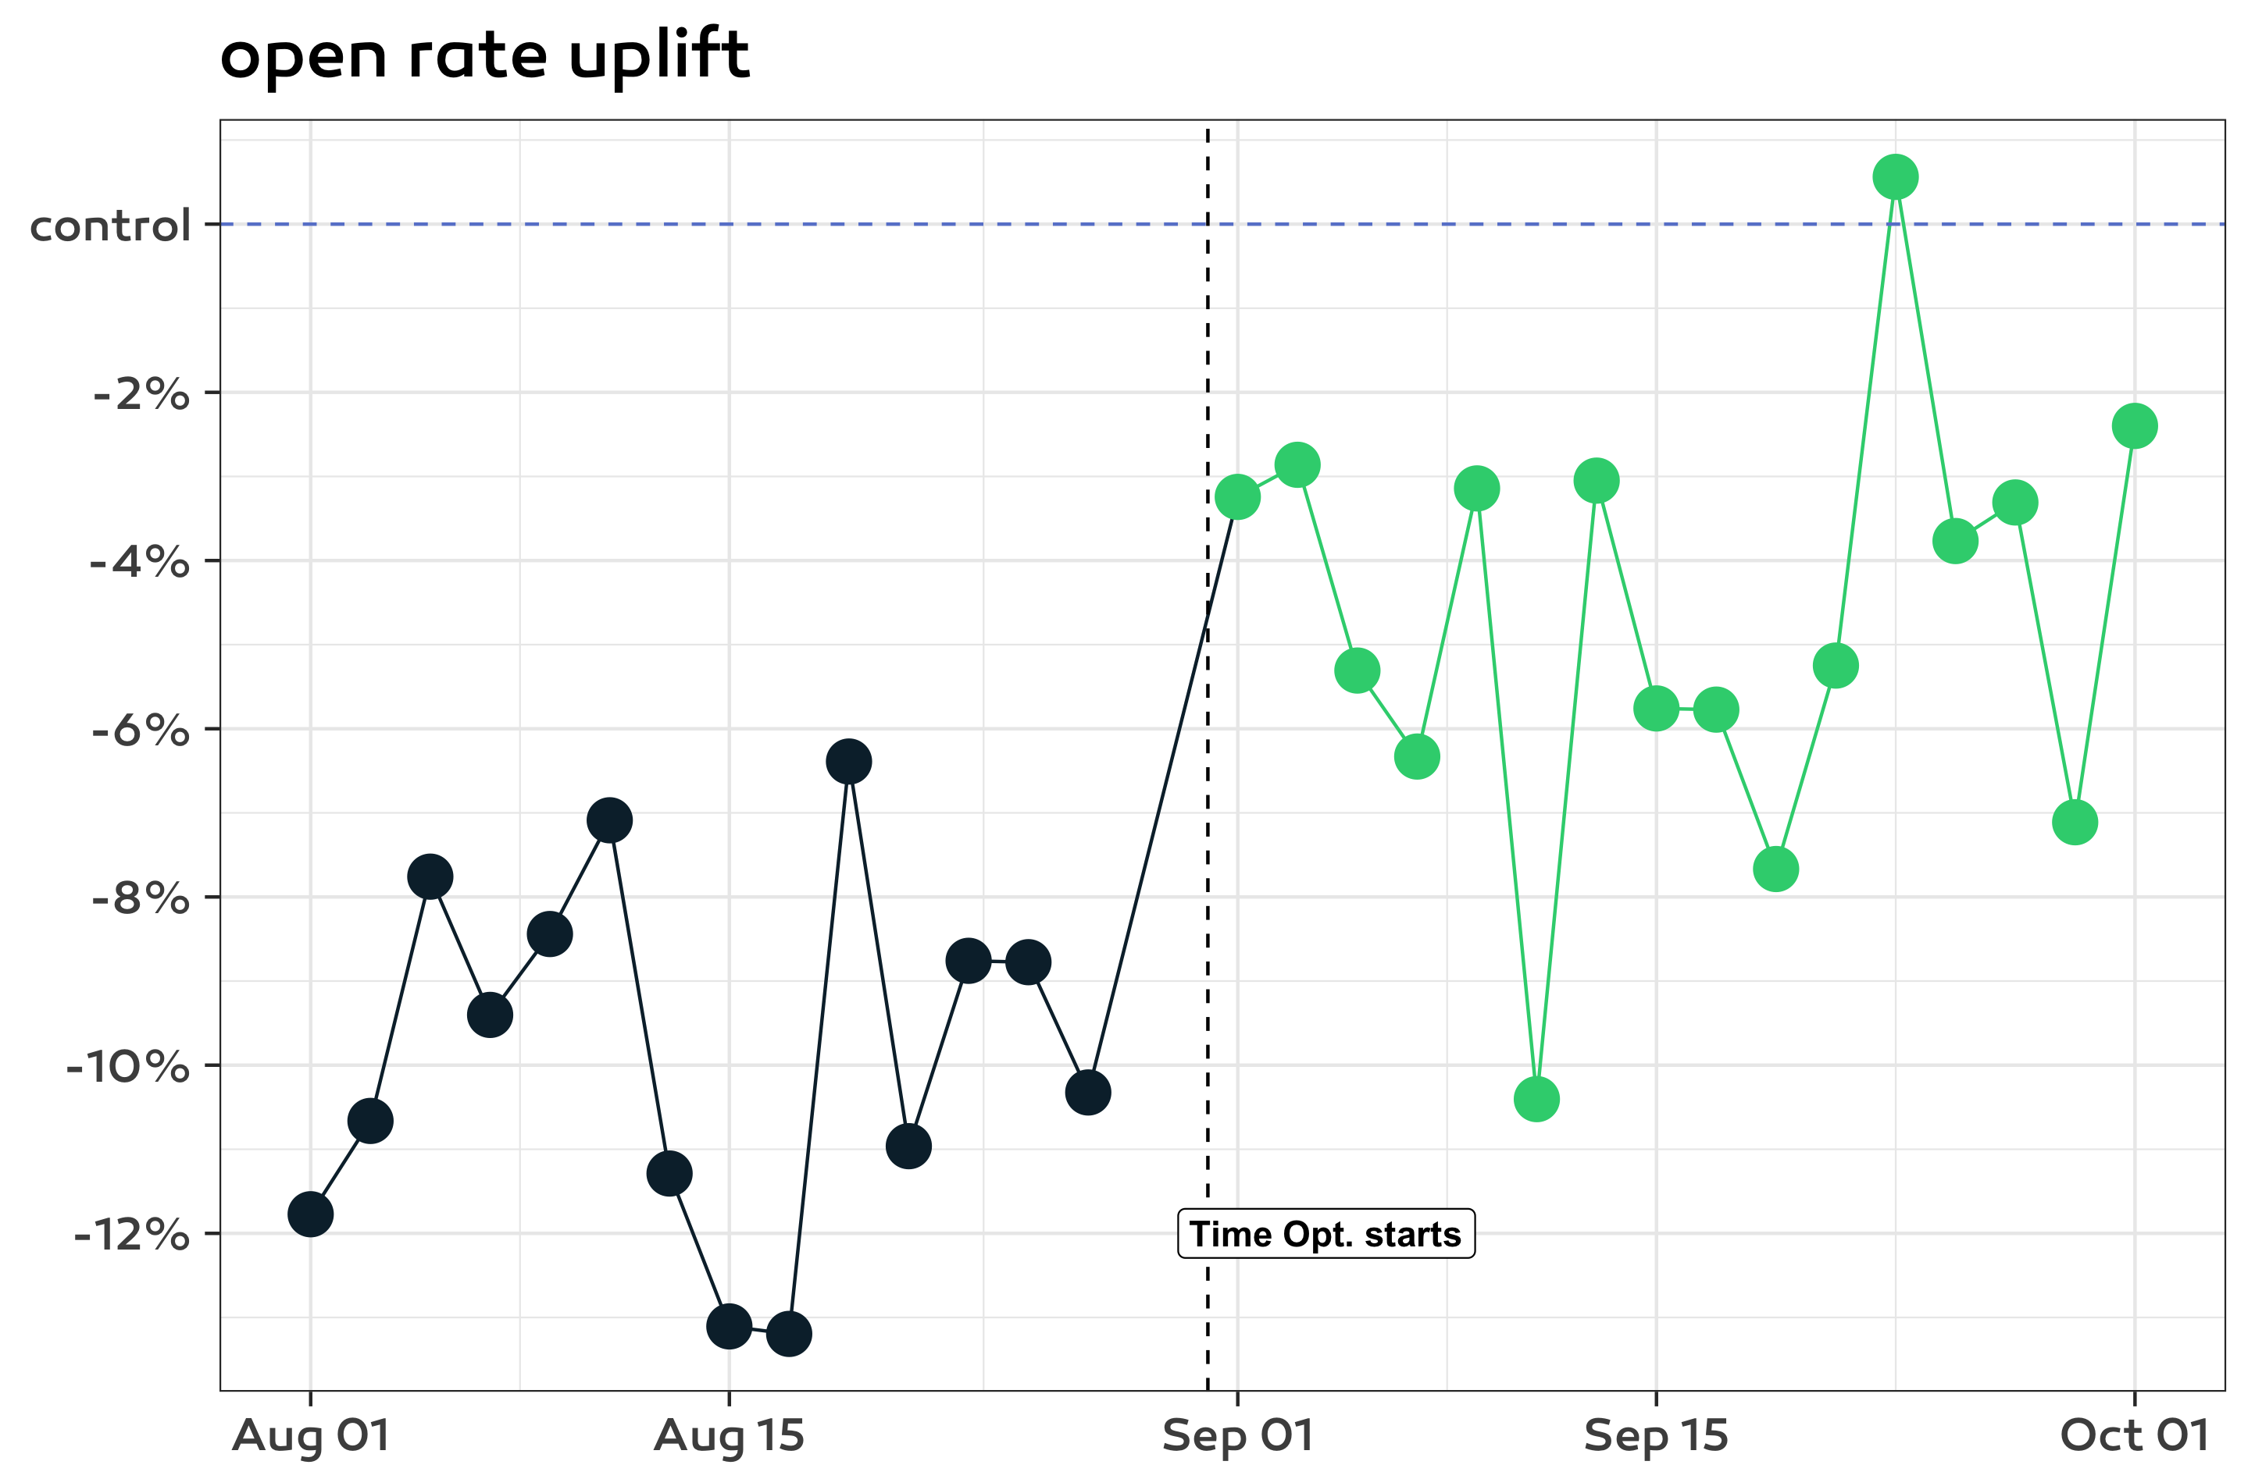
DISTORTED A/B TEST
Notes:
In this plot I added the previous period where both groups got exactly the same message at the same time. There the results are even worse which shows that this A/B test was distorted, we cannot say that the two groups only significantly differ in their treatment. We can also see that results actually improved by using send time optimization. Own the experiments, too risky to trust your customers and even yourself: check if A/B testing groups are similar enough.

Slide 29
2-12% uplift in engagement
Notes:
After this initial hiccup and several other adjustments this product turned out to be a great success as we observed uplift in opens clicks and purchases as well consistently with many clients after 10-20 campaigns. Usually there is immediate uplift

Slide 30
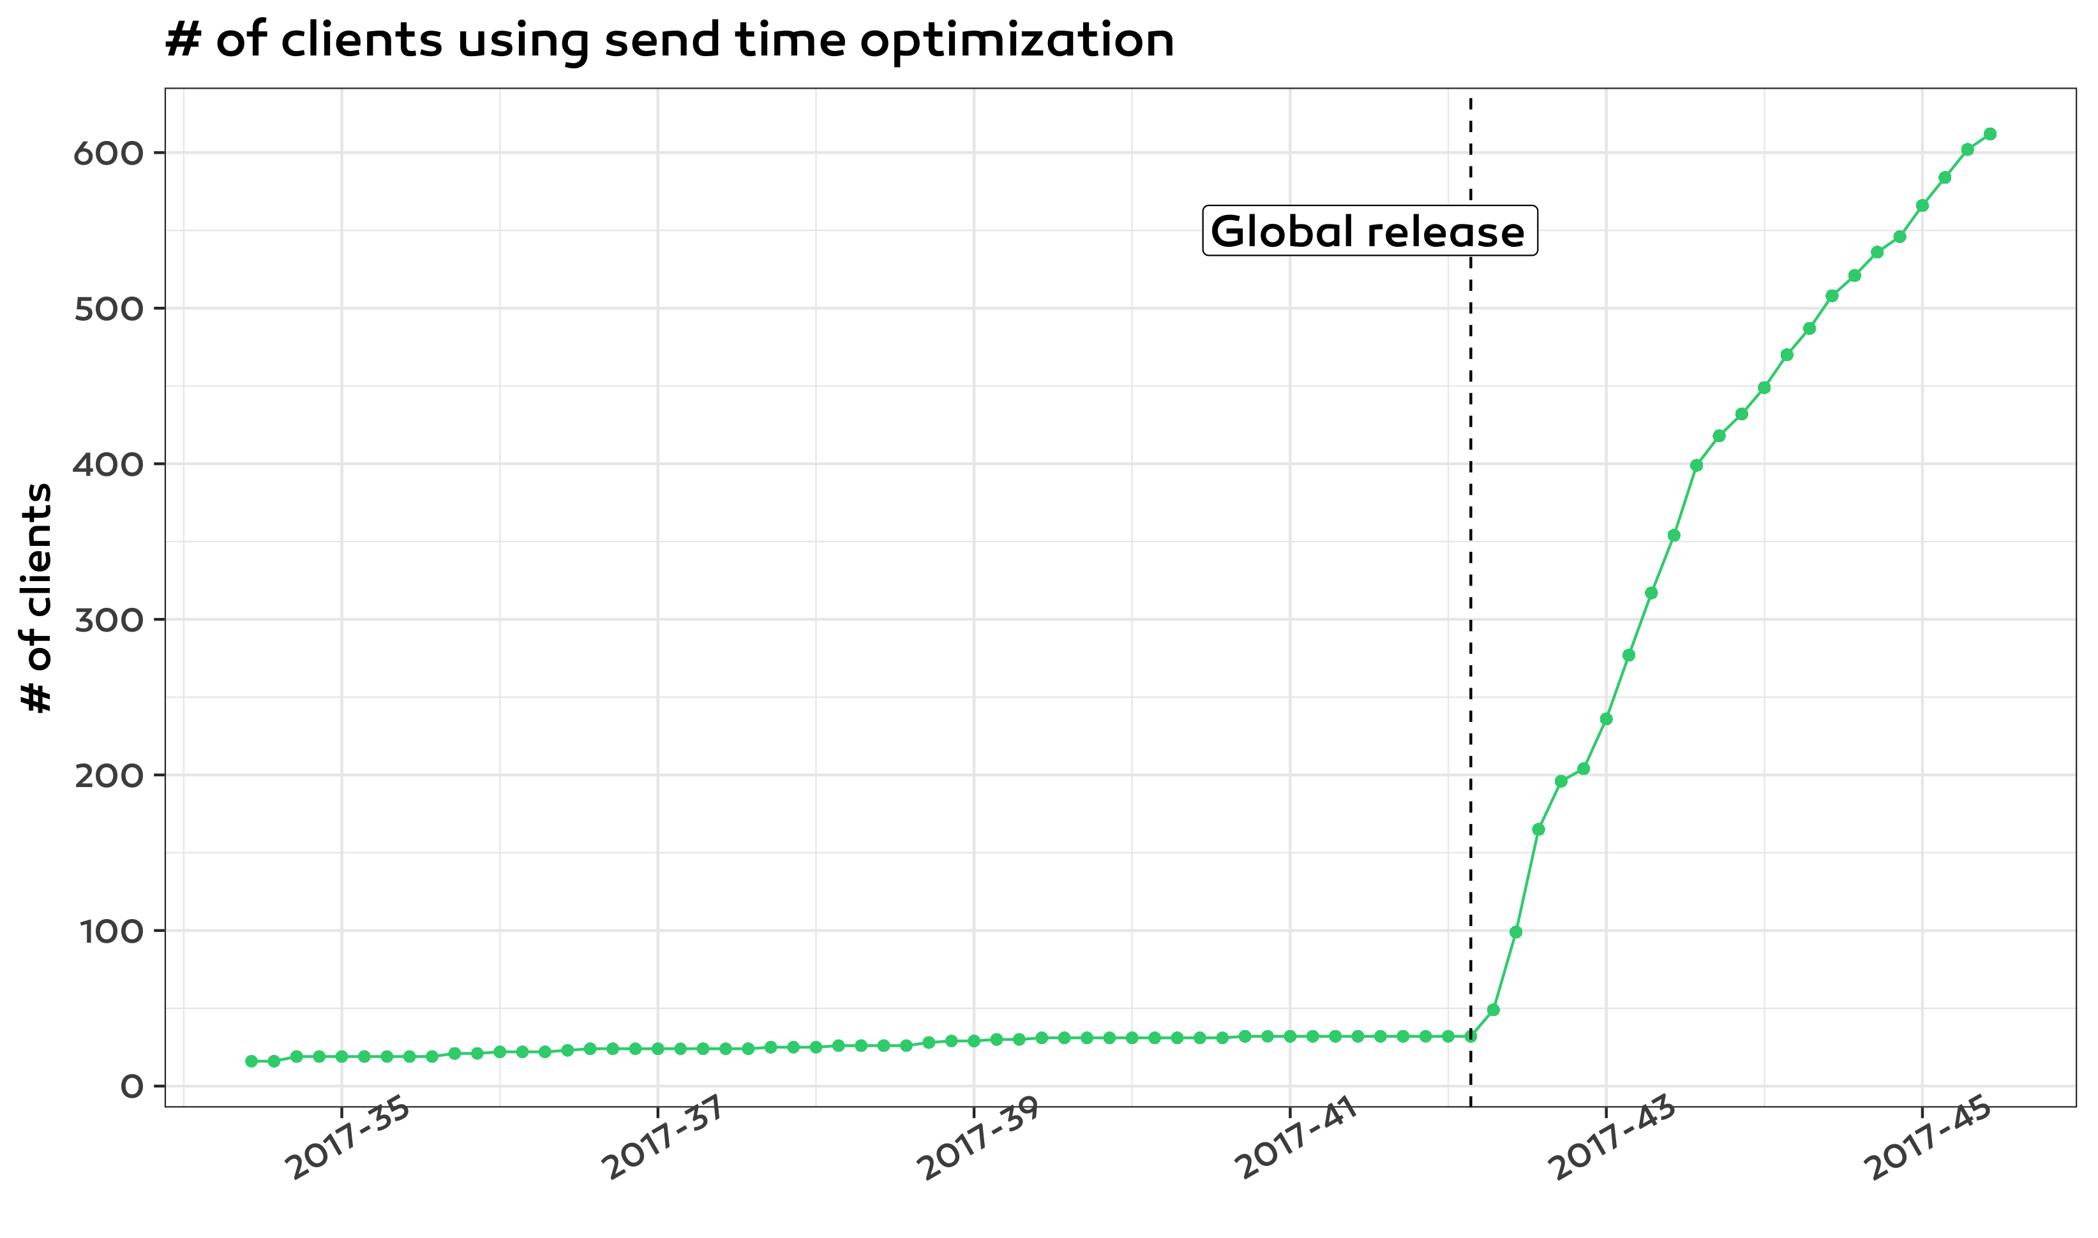
FAST adoption
Notes:
Another measure of success is the fast adoption after the global release: 2 weeks from 50 to 500 customers. At that time they did not need convincing but were waiting desperately to turn on this feature.

Slide 31
takeaway
Notes:
We learned an incredible amount along the way both about data science, our clients and how to best communicate with non technical people about machine learning solutions. Let’s summarise three key takeaways from this journey.

Slide 32
MANUAL A/B TESTS ARE RISKY
Notes:
Control if possible, and check if they are sufficiently similar. There is room for manual A/B testing: our clients could check the results themselves.

Slide 33
Learn cheaply FROM realistic simulations
Notes:
You can learn a lot without machine learning. It is important not to be overly optimistic in simulations, it is not safe if you have many params.

Slide 34
YOU NEED TRUST
Set expectations give explanations
Notes:
There is no successful machine learning product without trust. Especially if the machine learning is sometimes unintuitive which will happen.

Slide 35

Chris Stucchio blog.craftlab.hu/weekend-bias-in-send-time-optimisation-ba80176af1b9 @czeildi on twitter
Notes:
Here are a few references: Chris Stucchio writes greatly about business applications of bandit algorithms. There is another post in which I go into more detail about our solution and one particular incident. Thank you for your attention!

